Slide 1
Building a Spam Identifier SID
Alvin Reksaniardana, Jone Vuong, Lewis Harding and Murphy Guo

Slide 2
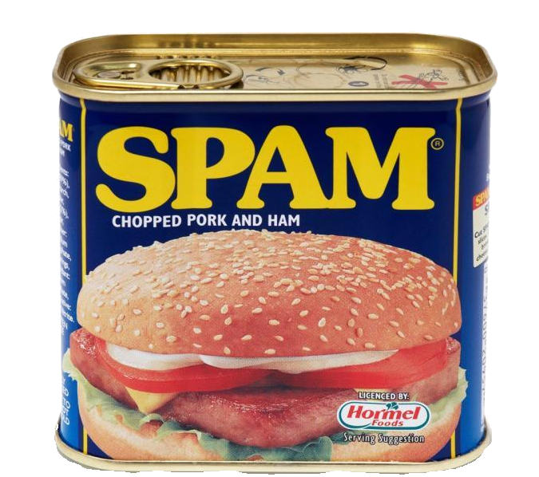
Spam

Slide 3

Objectives

Slide 4
Data
Variables | Description
numRecipients | The number of people in the To: or Cc: lines
Domain | Domain name of the sender’s email address
replyToSameAddress | Dummy where ‘1’ if the reply is sending to the same address as which the email was sent
Weekday | Day of the week
Hour | Hour of the day
percentLowerCase | % of lower case letters in the subject line
numDigits | Number of digits in the sender’s email address
percentNonLetters | % of non-letters in the sender’s email address
Size | Size of the mail in Kb
numLinks | Number of links in the email
localSender | Dummy where ‘1’ if the sender is in the local domain of the receiver
credit, porn, sucker, pharm, prescription, drugs, save, sex, discreet, free, sell, sale, asseenon and discount | Dummy where ‘1’ if the variable keyword is present in the email
newsletter | Dummy where ‘1’ if the email is basically a newsletter
mon, tue, wed, thu, fri and sat * | Dummy where ‘1’ depending on respective factor of Weekday
com, edu, net and org * | Dummy where ‘1’ depending on respective factor of Domain
spam | Response dummy where ‘1’ if the email is spam

Slide 5
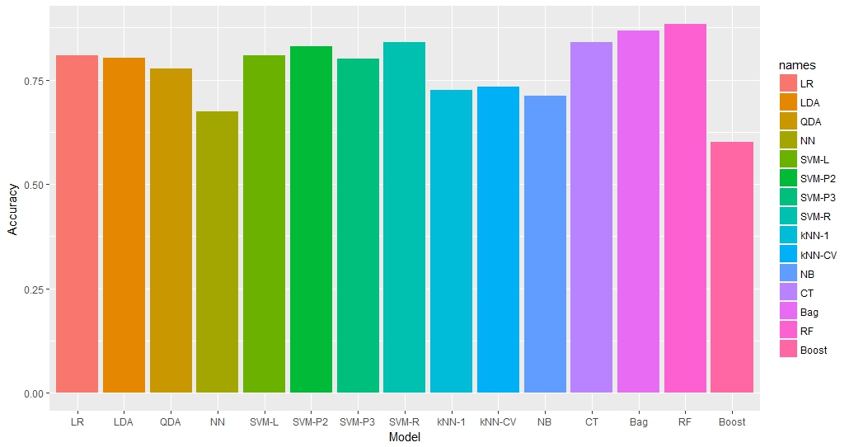
Classification Models
(Figure 1)

Slide 6
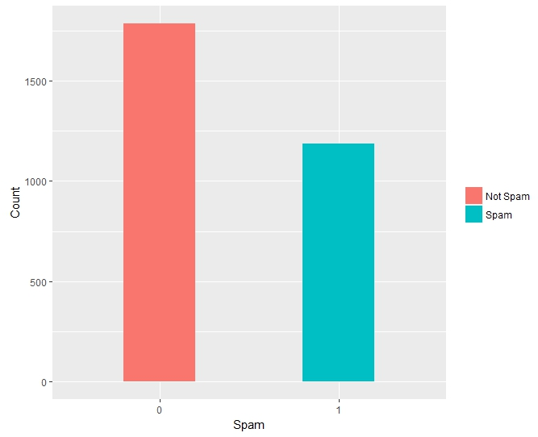
Summary Statistics
Not Spam | Spam
60.04% | 39.96%
(Figure 2)

Slide 7
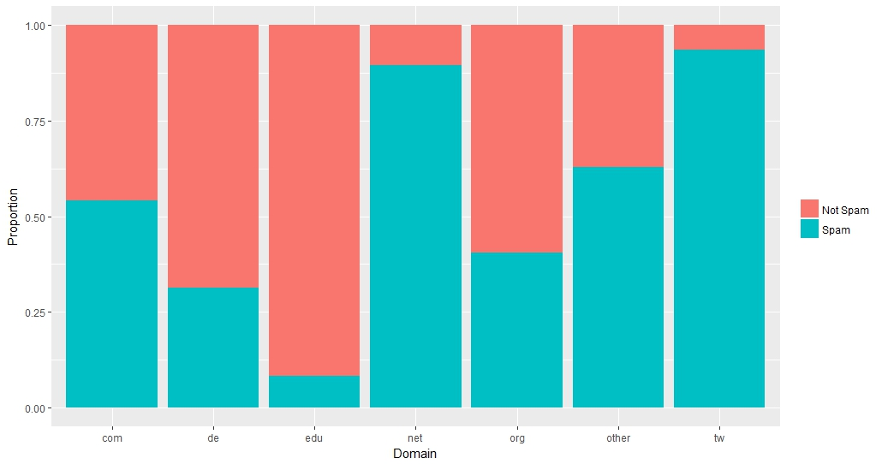
Plots
(Figure 3)

Slide 8
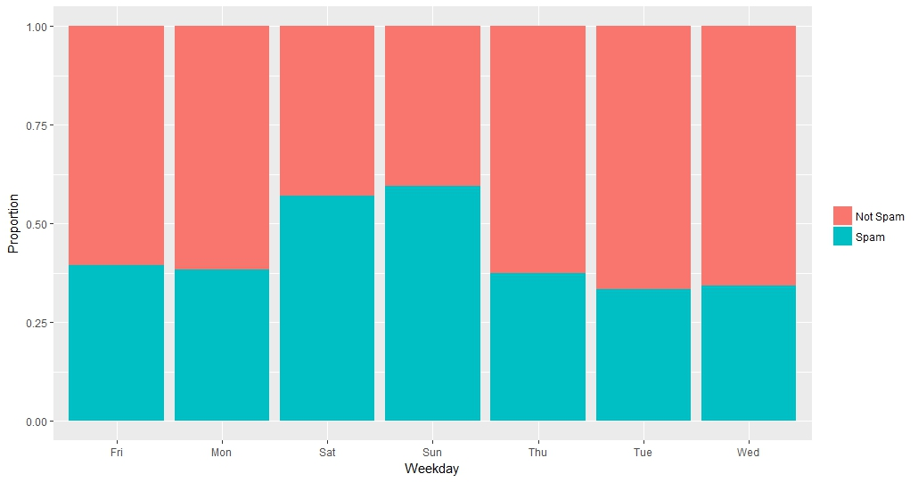
(Figure 4)

Slide 9
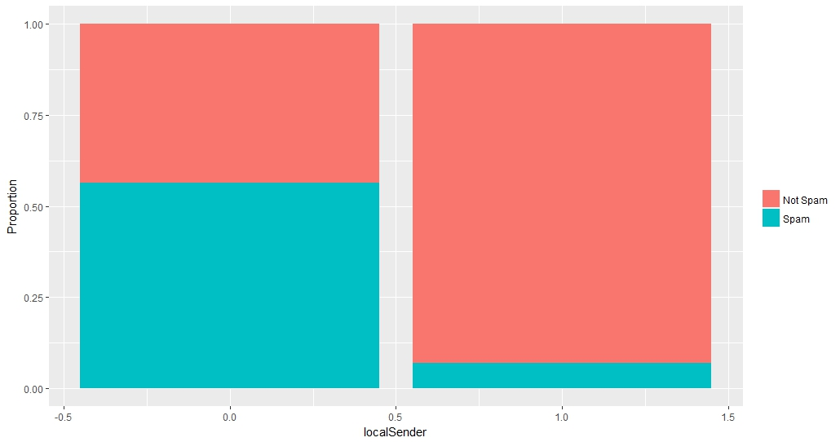
(Figure 5)

Slide 10
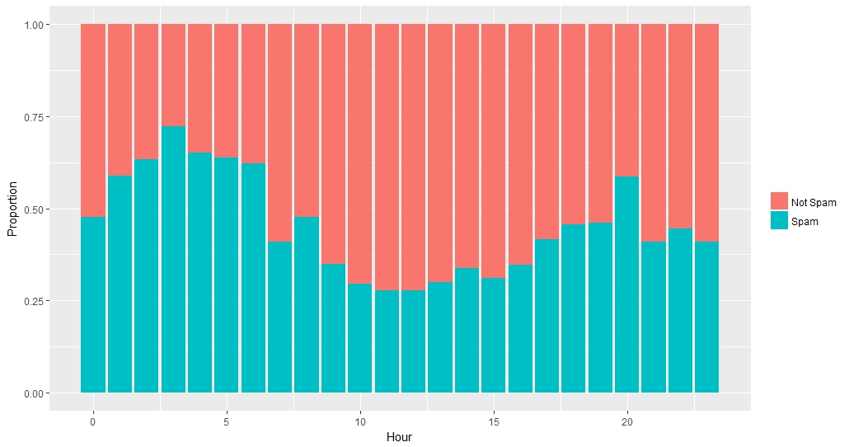
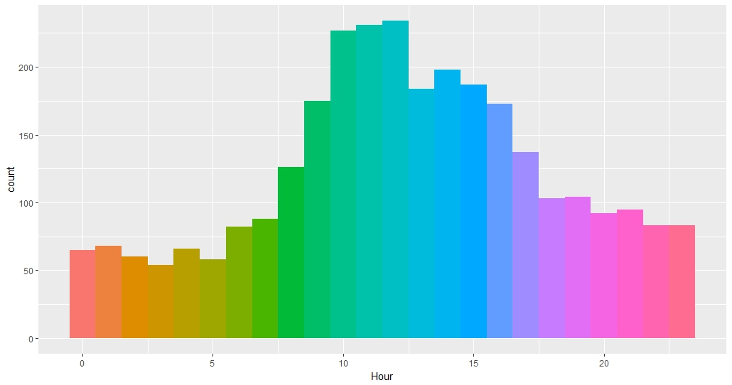
(Figure 6)
(Figure 7)

Slide 11
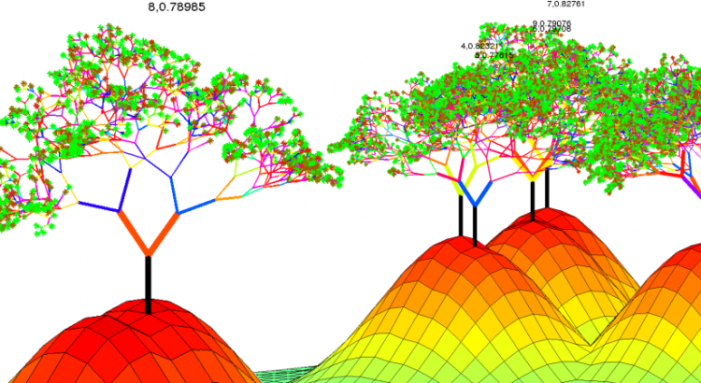
Random Forest
Model | Accuracy
Original Model | 88.26%
Final Model | 88.36%

Slide 12

Summary and Final Words

